Slide 1
Project Plan
Data Analysis with Elasticsearch (ELK) and Grafana
Birate Kabanza Arthur

Slide 2

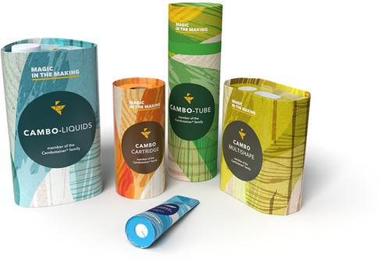
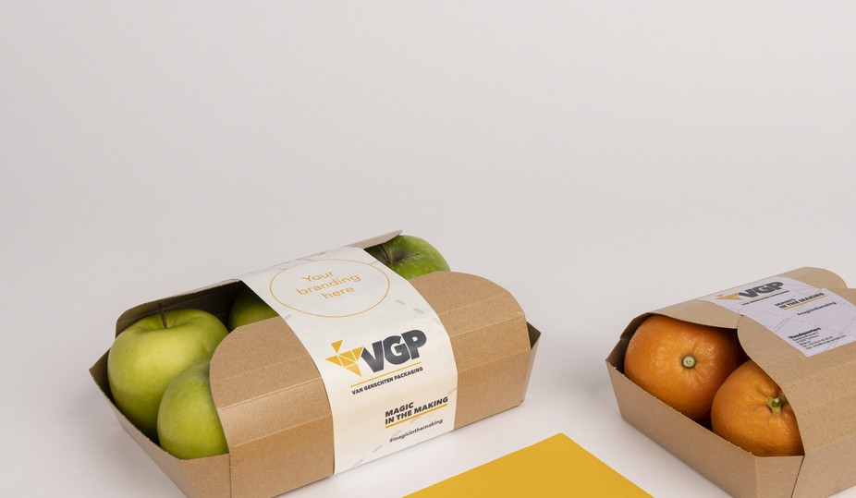
Van Genechten Packaging
Company Background
Van Genechten Packaging (VGP) is a leading European manufacturer of sustainable and innovative packaging solutions. With a history dating back over 180 years, the company specializes in folding carton packaging for various industries, including food, beverages, and consumer goods.

Slide 3
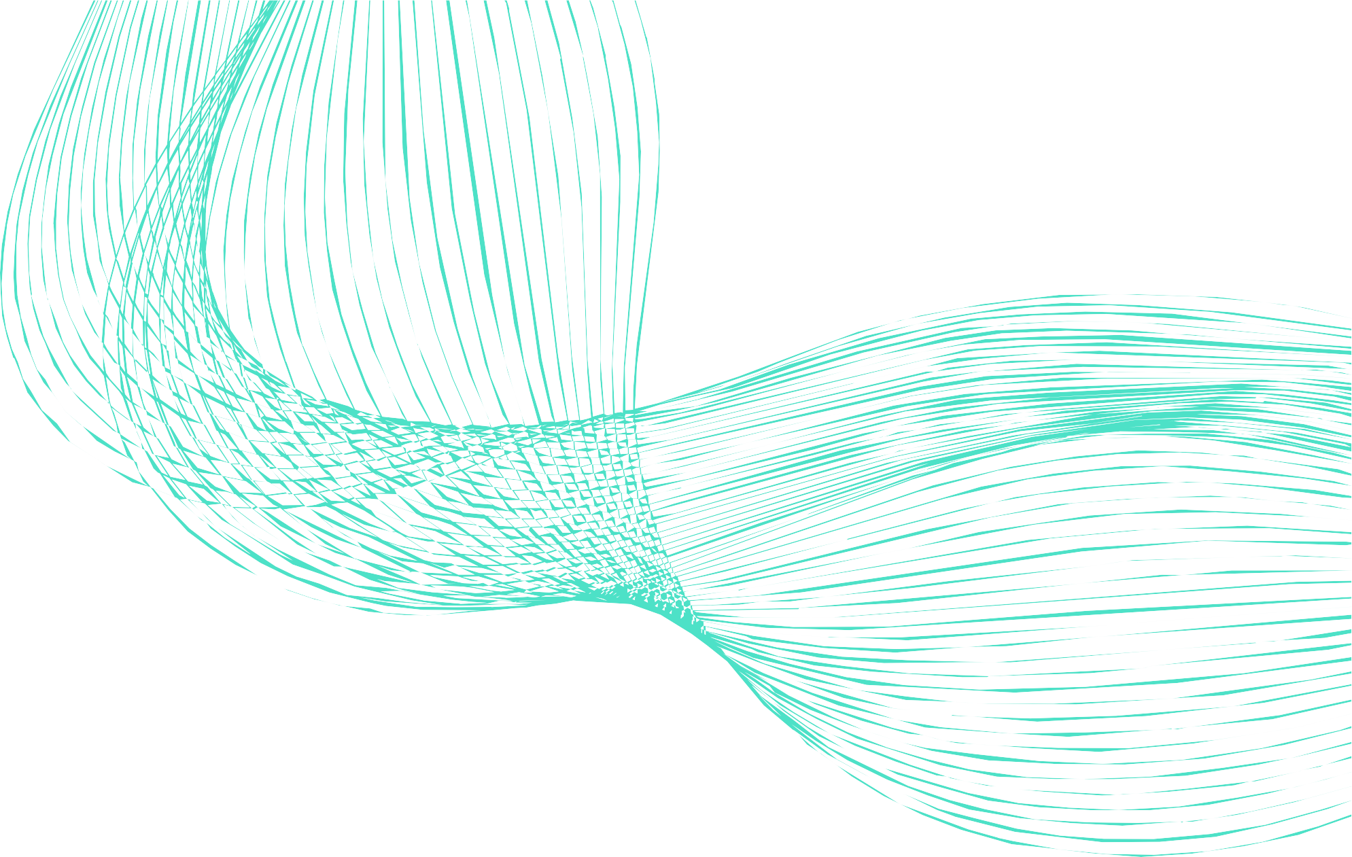



Project Scope and Objectives
Development of Dashboards
Implementation of Real- time Alerting & Reporting
Application of Machine Learning
use elasticsearch built in machine learning for anomaly detection to identify abnormality in log patterns and system metrics.
Configure automated alert for anomaly detection in logs and system performance.
Design and implement real- time Kibana and Grafana to monitor system logs and operational metrics.
Set up scheduled reporting to provide periodic insights of dashboards.
Utilize predictive analytics to anticipate potential failures and optimize system.

Slide 4
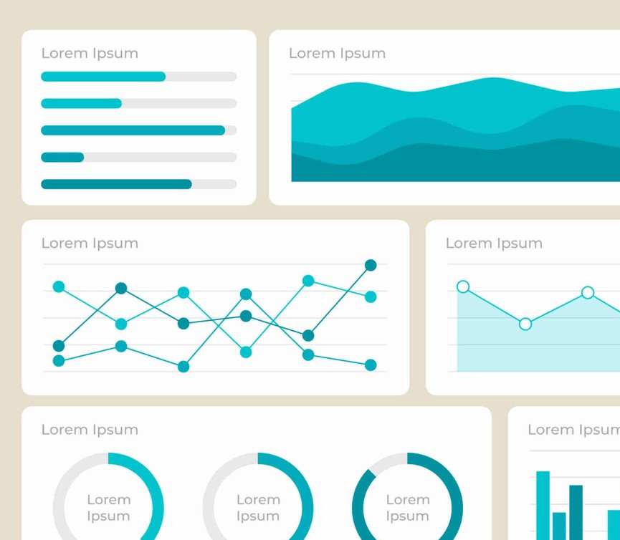
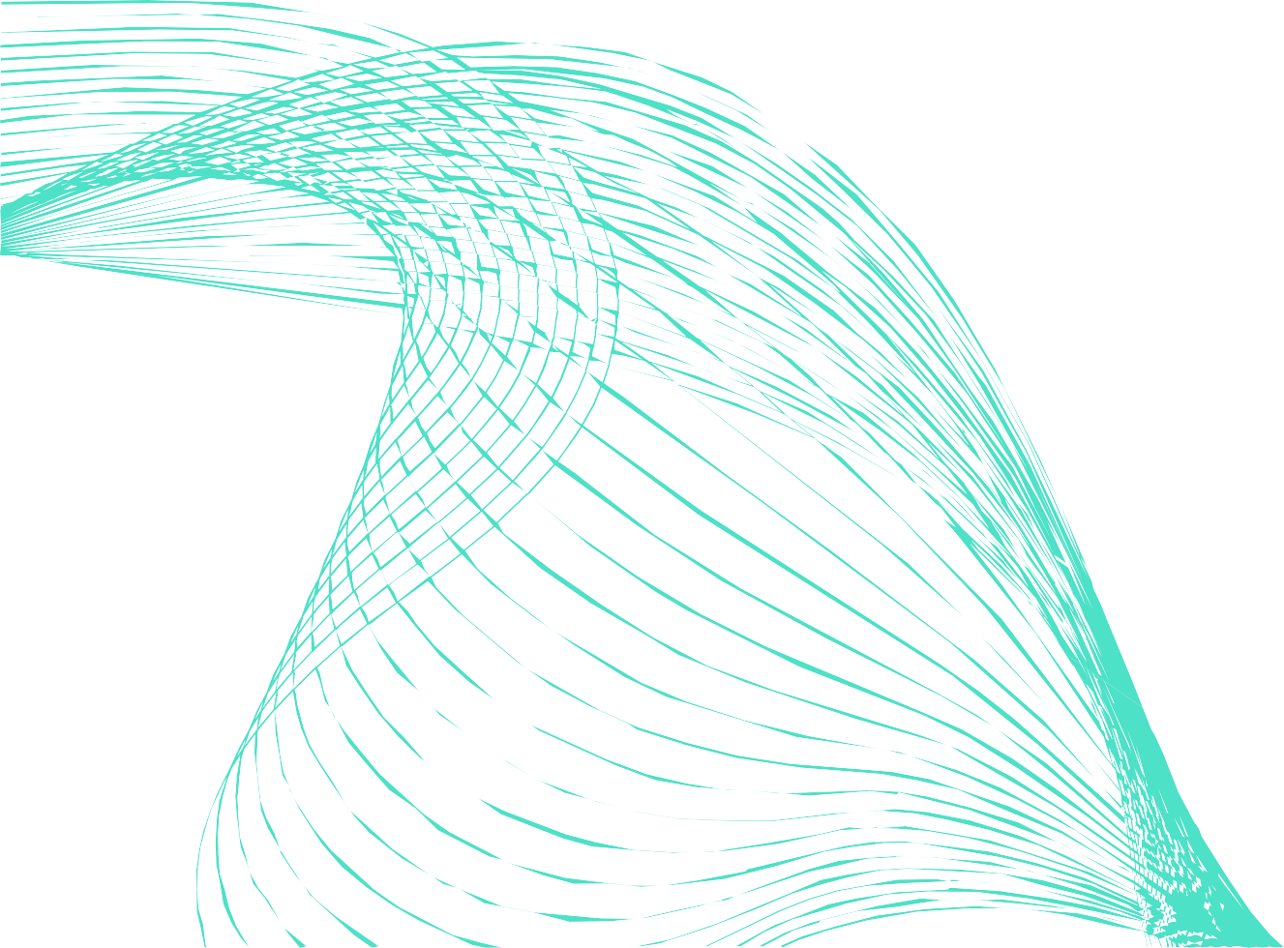
Phase 1 : data exploration and Understanding
Phase 2: Dashboard development & Machine Learning Integration
Project Phases and Tasks
Understanding data fields, indices and fenics data
Machine Learning:
Anomaly detection in logs.
ldentify relevant KPIs and metrics for analysis
Kibana Dashboards:
Log analysis : error trends , system performance, user activity.
Validate data completeness and correctness
Grafana Dashboards
Time-series trends (e.g. machine performance over time)
Phase 3: Machine Learning in Elasticsearch & Documentation
Anomaly detection : detect irregular system behavior
Predictive maintenance : Forecast potential production issues

Slide 5
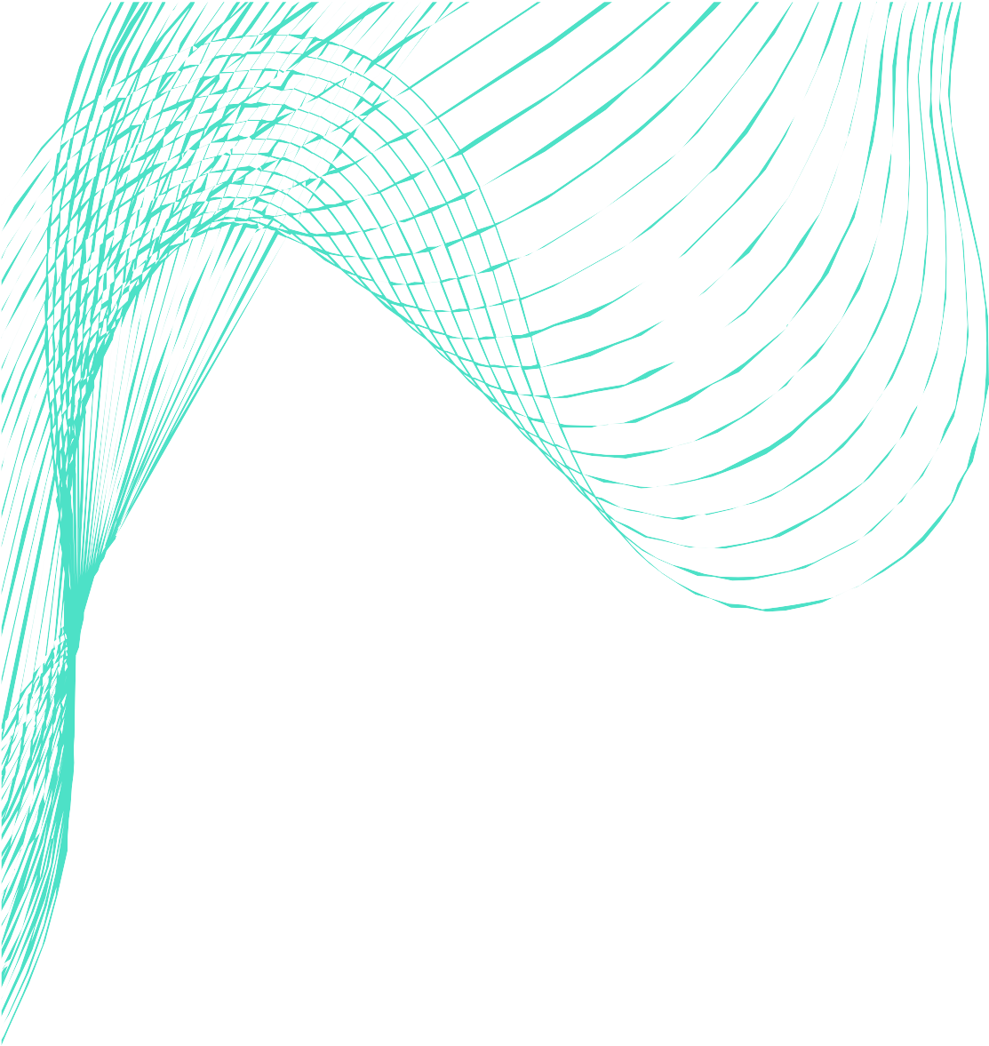
Week 1-2
Data exploration
Week 3-5
Dashboard creation and ML implementation
Week 6-7
Alerting and Reporting
3. Timeline and Milestone
Week 8-10
ML implementation
Week 11 - 12
Testing and Optimization
Week 13
Final report and presentation

Slide 6


3. Follow up and Progress
A weekly progress on Monday and Wednesday (Was later changed to Friday)

